Slide 1
|
J S S ACADEMY OF TECHNICAL EDUCATION
Module 5: Input& interaction, Curves and Computer Animation
VI Semester
Computer Graphics and Visualization
(18CS62)
By
IMPANA K P
Asst. Professor
Department of Computer Science and Engineering

Slide 2
TABLE OF CONTENTS
Interaction
Input devices
Client Server

Slide 3

INTERACTION
In the field of computer graphics, interaction refers to the manner in which the application program communicates with input and output devices of the system.
For e.g. Image varying in response to the input from the user.
OpenGL doesn‟t directly support interaction in order to maintain portability. However, OpenGL provides the GLUT library. This library supports interaction with the keyboard, mouse etc and hence enables interaction. The GLUT library is compatible with many operating systems such as X windows, Current Windows, Mac OS etc and hence indirectly ensures the portability of OpenGL.

Slide 4
INPUT DEVICES
Input devices are the devices which provide input to the computer graphics application program. Input devices can be categorized in two ways:
Physical input devices
Logical input devices

Slide 5
PHYSICAL INPUT DEVICES
PHYSICAL INPUT DEVICES :Physical input devices are the input devices which has the particular hardware architecture.
The two major categories in physical input devices are:
Key board devices: like standard keyboard, flexible keyboard, handheld keyboard etc. These are used to provide character input like letters, numbers, symbols etc.
Pointing devices: like mouse, track ball, light pen etc. These are used to specify the position on the computer screen

Slide 6
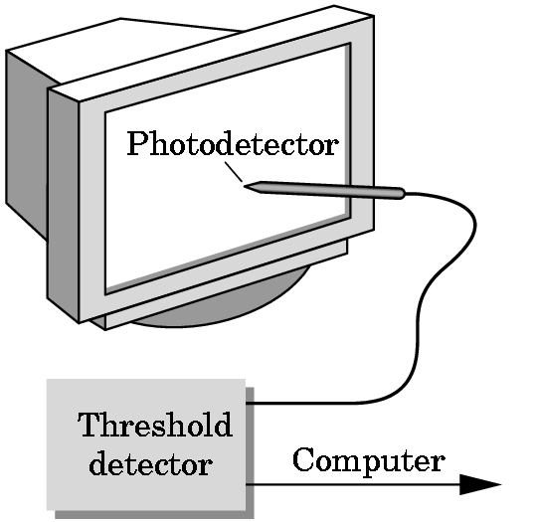
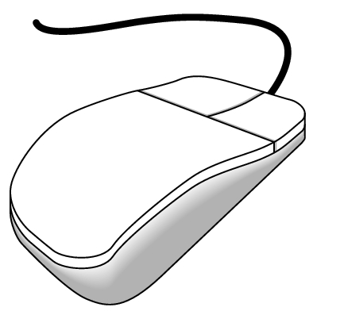
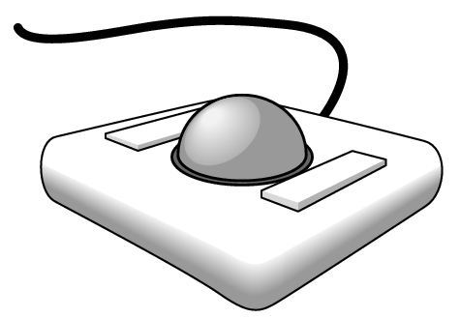
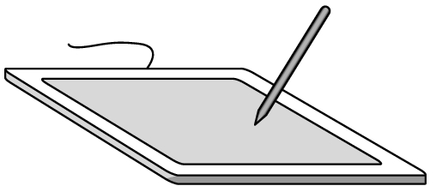
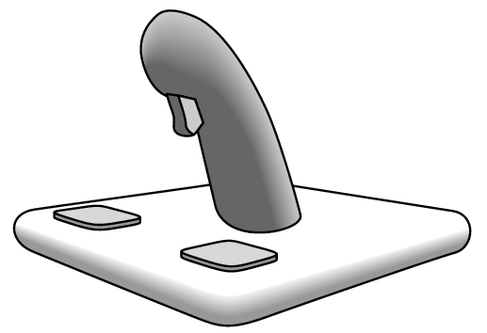
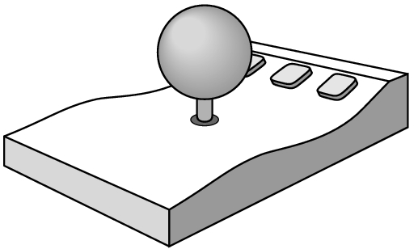
PHYSICAL DEVICES
mouse
trackball
light pen
data tablet
joy stick
space ball
Angel and Shreiner: Interactive Computer Graphics 7E © Addison-Wesley 2015

Slide 7
INCREMENTAL (RELATIVE) DEVICES
Devices such as the data tablet return a position directly to the operating system
Devices such as the mouse, trackball, and joy stick return incremental inputs (or velocities) to the operating system .Must integrate these inputs to obtain an absolute position
    Rotation of cylinders in mouse
    Roll of trackball
    Difficult to obtain absolute position
    Can get variable sensitivity

Slide 8
LOGICAL DEVICES
Consider the C and C++ code
  C++: cin >> x;
  C: scanf (“%d”, &x);
What is the input device?
  Can’t tell from the code
  Could be keyboard, file, output from another program
The code provides logical input
  A number (an int) is returned to the program regardless of the physical device

Slide 9
GRAPHICAL LOGICAL DEVICES
Graphical input is more varied than input to standard programs which is usually numbers, characters, or bits
Two older APIs (GKS, PHIGS) defined six types of logical input
  Locator: return a position
  Pick: return ID of an object
  Keyboard: return strings of characters
  Stroke: return array of positions
  Valuator: return floating point number
  Choice: return one of n items

Slide 10
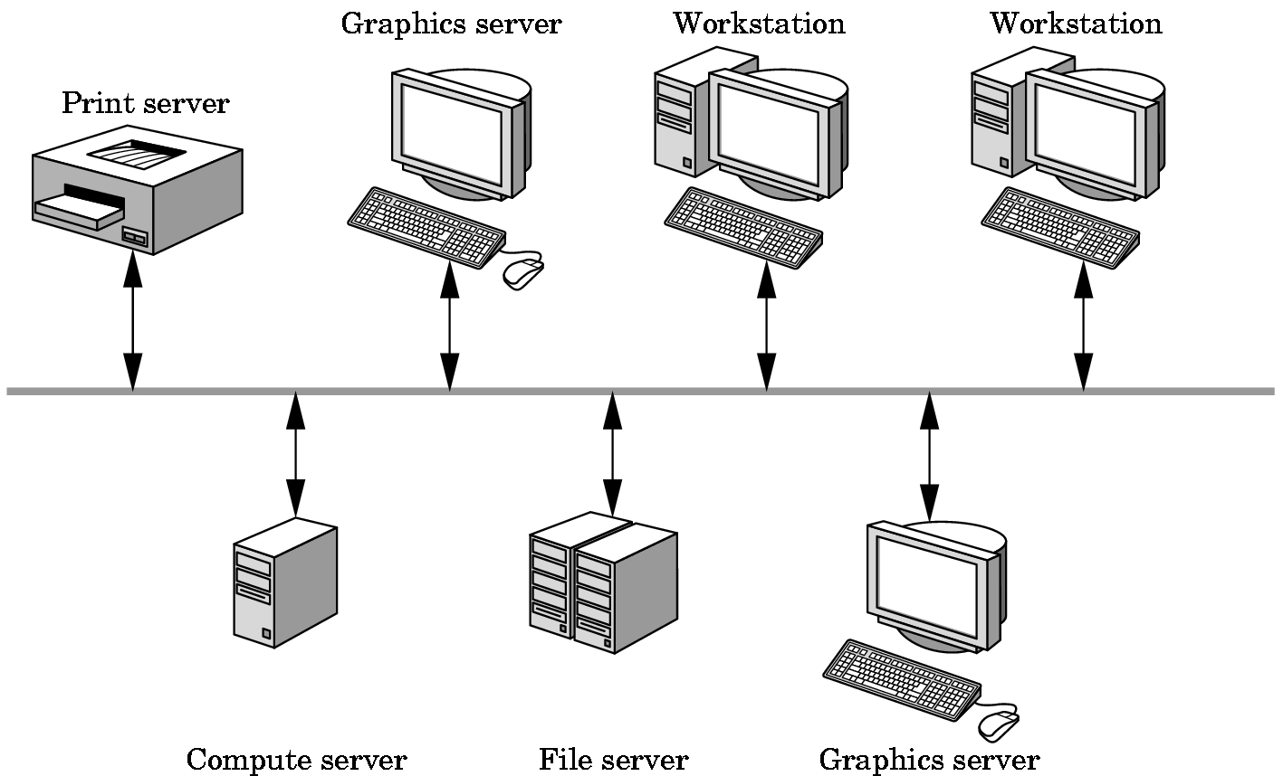
X WINDOW INPUT
The X Window System introduced a client-server model for a network of workstations
  Client: OpenGL program
  Graphics Server: bitmap display with a pointing device and a keyboard

Slide 11
INPUT MODES
Input devices contain a trigger which can be used to send a signal to the operating system
  Button on mouse
  Pressing or releasing a key
When triggered, input devices return information (their measure) to the system
  Mouse returns position information
  Keyboard returns ASCII code
The application program can obtain the measure and trigger in three distinct modes:

Slide 12
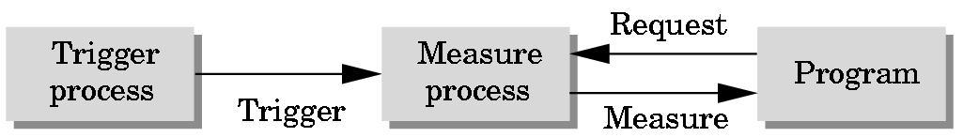
REQUEST MODE
REQUEST MODE
Input provided to program only when user triggers the device
Typical of keyboard input
  Can erase (backspace), edit, correct until enter (return) key (the trigger) is depressed

Slide 13
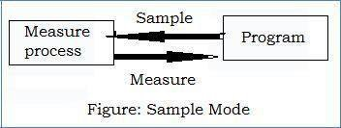
SAMPLE MODE
SAMPLE MODE: In this mode, input is immediate. As soon as the function call in the user program
is executed, the measure is returned. Hence no trigger is needed.
Both request and sample modes are useful for the situation if and only if there is a single input device from which the input is to be taken. However, in case of flight simulators or computer games variety of input devices are used and these mode cannot be used. Thus, event mode is used

Slide 14
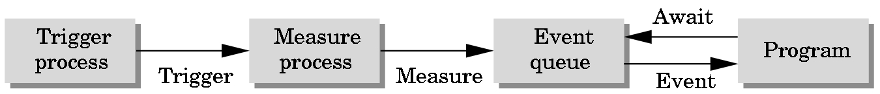
EVENT MODE
Most systems have more than one input device, each of which can be triggered at an arbitrary time by a user
Each trigger generates an event whose measure is put in an event queue which can be examined by the user program

Slide 15
EVENT TYPES
Window: resize, expose, iconify
Mouse: click one or more buttons
Motion: move mouse
Keyboard: press or release a key
Idle: nonevent
  Define what should be done if no other event is in queue

Slide 16
CLIENT AND SERVER
• The computer graphics architecture is based on the client-server model.
I.e., if computer graphics is to be useful for variety of real applications, it must
function well in a world of distributed computing and network.
• In this architecture the building blocks are entities called as “servers”
perform the tasks requested by the “client”
• Servers and clients can be distributed over a network or can be present
within a single system. Today most of the computing is done in the form
of distributed based and network based as shown below:

Slide 17
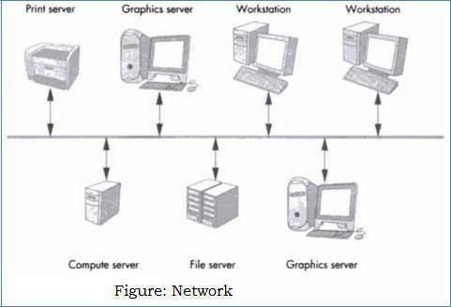
Most popular examples of servers are print servers – which allow using high speed printer devices among multiple users. File servers – allow users to share files and programs.
• Users or clients will make use of these services with the help of user programs or client programs. The OpenGL application programs are the client programs that use the services provided by the graphics server.
• Even if we have single user isolated system, the interaction would be configured as client-server model.

Slide 18
TABLE OF CONTENTS
DISPLAY LISTS
DISPLAY LIST AND MODELING
PROGRAMMING EVENT DRIVEN INPUT
DISPLAY AND IDLE CALLBACKS

Slide 19
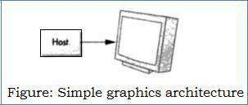
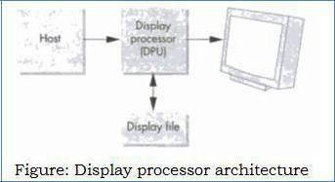
DISPLAY LISTS
A DISPLAY LIST IN COMPUTER GRAPHICS IS A SEQUENCE OF COMMANDS THAT, WHEN EXECUTED, PROVIDES INSTRUCTIONS ON HOW TO DRAW AN OBJECT TO THE SCREEN OR OTHER OUTPUT DEVICE
The original architecture of a graphical system was based on a general-purpose computer connected to a display.
The disadvantage is that system was slow and expensive.
A special purpose computer is build which is known as “display processor”.
The user program is processed by the host computer which results a compiled list of instruction that was then sent to the display processor, where the instruction are stored in a display memory called as “display file” or “display list”. Display processor executes its display list contents repeatedly at a sufficient high rate to produce flicker-free image.

Slide 20
TWO MODES IN WHICH OBJECTS CAN BE DRAWN ON THE SCREEN:
IMMEDIATE MODE: This mode sends the complete description of the object which needs to be drawn to the graphics server and no data can be retained. i.e., to redisplay the same object, the program must re-send the information. The information includes vertices, attributes, primitive types, viewing details.
RETAINED MODE: This mode is offered by the display lists. The object isdefined once and its description is stored in a display list which is at the server side and redisplay of the object can be done by a simple function call issued by the client to the server.

Slide 21
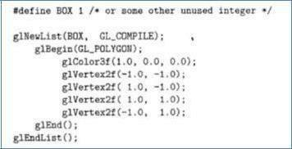
PHYSICAL INPUT DEVICES
Display lists are defined similarly to the geometric primitives. i.e.,glNewList() at the beginning and glEndList() at the end is used to define a display list.
Each display list must have a unique identifier – an integer that isusually a macro defined in the C program by means of #define directive to an appropriate name for the object in the list. For example, the following code defines red box:
The flag GL_COMPILE indicates the system to send the list to the server but not to display its contents.
If we want an immediate display of the contents while the list is being constructed then
GL_COMPILE_AND_EXECUTE flag is set.

Slide 22
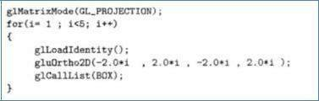
Each time if the client wishes to redraw the box on the display, it need not resend the entire description. Rather, it can call the following function:
glCallList(Box)
The Box can be made to appear at different places on the monitor by changing the projection matrix as shown below:

Slide 23
OpenGL provides an API to retain the information by using stack – It is adata structure in which the item placed most recently is removed first[LIFO].
We can save the present values of the attributes and the matrices by pushing them into the stack, usually the below function calls are placed atthe beginning of the display list,
glPushAttrib(GL_ALL_ATTRIB_BITS);
glPushMatrix();
We can retrieve these values by popping them from the stack :glPopMatrix();
multiple lists is created with consecutive identifiers using: glGenLists (number)
We can display multiple display lists by using single function call: glCallLists()

Slide 24

TEXT AND DISPLAY LISTS
There are two types of text i.e., raster text and stroke text which can be generated.
For example, let us consider a raster text character is to be drawn of size 8x13 pattern of bits. It takes 13 bytes to store each character.
If we define a stroke font using only line segments, each character requires a different number of lines.
From the figure we can observe to draw letter „I‟ is fairly simple, whereas drawing „O‟ requires many line segments to get sufficiently smooth.
So, on the average we need more than 13 bytes per character to represent stroke font. The performance of the graphics system will be degraded for the applications that require large quantity of text.

Slide 25
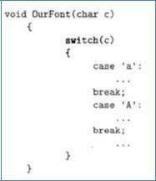
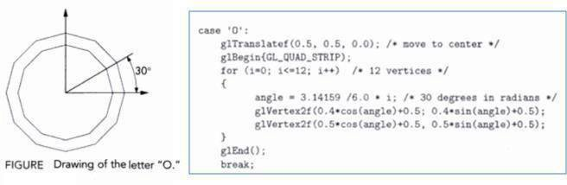
A more efficient strategy is to define the font once, using a display list for each char and then store in the server. We define a function OurFont( ) which will draw any ASCII character stored in variable
The function may have the form: For the character „O‟ the code sequence is of the form as shown below

Slide 26
To display char from the list, offset is set by using glListBase(base) function. The drawing of a string is accomplished in the server by the following function, char *text_string;
glCallLists((GLint) strlen (text_string), GL_BYTE, text_string);
The glCallLists has three arguments:
(1) indicates number of lists to be executed
(2) indicates the type
(3) is a pointer to an array of a type given by second argument.

Slide 27
FONTS IN GLUT
GLUT provides raster and stroke fonts; they do not make use of display list • glutStrokeCharacter(GLUT_STROKE_MONO_ROMAN, int character);
provides proportionally space characters. Position of a character is done by using a translation before the character function is called.
glutBitmapCharacter(GLUT_BITMAP_8_BY_13, int character);
produces the bitmap characters of size 8x13.

Slide 28
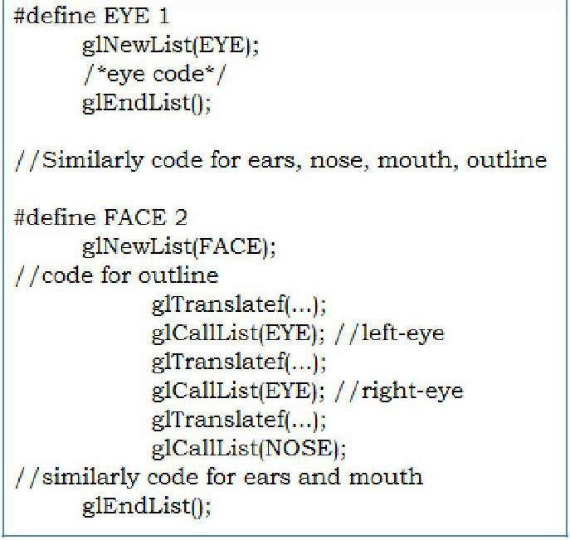
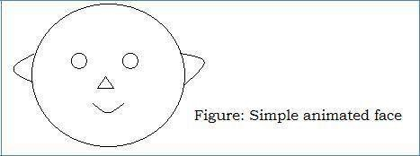
DISPLAY LIST AND MODELING
Display list can call other display list. Therefore, they are powerful tool for building hierarchical models that can incorporate relationships among parts of a model.
Consider a simple face modeling system that can produce images asfollows:
Each face has two identical eyes, two identical ears, one nose, one mouth& an outline. We can specify these parts through display lists which is given below:

Slide 29
PROGRAMMING EVENT DRIVEN INPUT
The various events can be recognized by the window system and call back function can be called for each of these events
Pointing devices like mouse, trackball, data tablet allow programmer to indicate a position on the display.
There are two types of event associated with pointing device, which is conventionally assumed to be mouse but could be trackball or data tablet also.
1. MOVE EVENT – is generated when the mouse is move with one of the button being pressed. If the mouse is moved without a button being pressed, this event is called as “passive move event”.
2. MOUSE EVENT – is generated when one of the mouse buttons is either pressed or released.

Slide 30
PROGRAMMING A MOUSE EVENT INVOLVES TWO STEPS:
1.The mouse callback function must be defined in the form: voidmyMouse(int button, int state, int x, int y) is written by the programmer.
For example, void myMouse(int button, int state, int x, int y)
{if(button==GLUT_LEFT_BUTTON && state == GLUT_DOWN)
exit(0);}:This code ensures whenever the left mouse button is pressed down, execution of the program gets terminated.
2. Register the defined mouse callback function in the main function, by means of GLUT function:
glutMouseFunc(myMouse);

Slide 31
KEYBOARD EVENTS
Keyboard devices are input devices which return the ASCII value to the user program. Keyboard events are generated when the mouse is in the window and one of the keys is pressed or released.
GLUT supports following two functions:
• glutKeyboardFunc() is the callback for events generated by pressing a key
• glutKeyboardUpFunc() is the callback for events generated by releasing a key.:

Slide 32
PROGRAMMING KEYBOARD EVENT INVOLVES TWO STEPS
1. The keyboard callback function must be defined in the form:
void mykey (unsigned char key, int x, int y)is written by the application programmer.
For example, void mykey(unsigned char key, int x, int y)
{if(key== „q‟ || key== „Q‟)exit(0);}
The above code ensures when „Q‟ or „q‟ key is pressed, the execution of the program gets terminated.
2. The keyboard callback function must be registered in the main function by means of GLUT function:
glutKeyboardFunc(mykey);

Slide 33
WINDOW EVENTS
A window event is occurred when the corner of the window is dragged to new position or size of window is minimized or maximized by using mouse.
The information returned to the program includes the height and width of newly resized window. Programming the window event involves two steps.
1. Window call back function must be defined in the form:
void myReshape(GLsizei w, GLsizei h) is written by the application programmer.
2. The window callback function must be registered in the main function,
glutReshapeFunc(myReshape);

Slide 34
THE DISPLAY AND IDLE CALLBACKS
Display callback is specified by GLUT using
glutDisplayFunc(myDisplay). It is invoked when GLUT determines that window should be redisplayed. Re-execution of the display function can be achieved by using glutPostRedisplay().
The idle callback is invoked when there are no other events. It isv specified by GLUT using glutIdleFunc(myIdle).

Slide 35
WINDOW MANAGEMENT
GLUT also supports multiple windows of a given window. We can create a second top-level window as follows:
id = glutCreateWindow(“second window”);
The returned integer value allows us to select this window as the current window.
i.e., glutSetWindow(id);

Slide 36
TABLE OF CONTENTS
MENUS
PICKING
A SIMPLE CAD PROGRAM
BUILDING INTERACTIVE MODELS
ANIMATING INTERACTIVE PROGRAMS
DOUBLE BUFFERING:
DESIGN OF INTERACTIVE PROGRAMS

Slide 37

MENUS
Menus are an important feature of any application program. OpenGL provides a feature called “Pop-up-menus” using which sophisticated interactive applications can be created.
Menu creation involves the following steps:
1. Define the actions corresponding to each entry in the menu.
2. Link the menu to a corresponding mouse button.
3. Register a callback function for each entry in the menu.

Slide 38
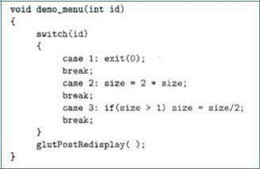
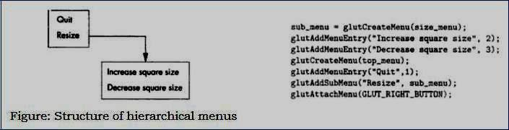
The glutCreateMenu() registers the callback function demo_menu.
The function glutAddMenuEntry() adds the entry in the menu whose name is pased in first argument and the second argument is the identifier passed to the callback when the entry is selected.
GLUT also supports the creation of hierarchical menus which is given below:

Slide 39
PICKING
Picking is the logical input operation that allows the user to identify an object on the display.
The action of picking uses pointing device but the information returned to the application program is the identifier of an object not a position.
It is difficult to implement picking in modern system because of graphics pipeline architecture. Therefore, converting from location on the display to the corresponding primitive is not direct calculation.
There are at least three ways to deal with this difficulty:
Selection
Bounding boxes or extents:
Usage of back buffer and extra rendering:

Slide 40
Hit list
  Most general approach but most difficult to implement
Use back or some other buffer to store object ids as the objects are rendered
Rectangular maps
  Easy to implement for many applications
  See paint program in text

Slide 41
Picking can be performed in four steps that are initiated by user defined pick function in the application:
We draw the objects into back buffer with the pick colors.
We get the position of the mouse using the mouse callback.
Use glReadPixels() to find the color at the position in the frame buffer corresponding to the mouse position.
We search table of colors to find the object corresponds to the color read.

Slide 42
PICKING AND SELECTION MODE
The difficulty in implementing the picking is we cannot go backward directly from the position of the mouse to the primitives.
OpenGL provides “selection mode” to do picking. The glRenderMode() is used to choose select mode by passing GL_SELECT value.
When we enter selection mode and render a scene, each primitive within he clipping volume generates a message called “hit” that is stored in a buffer called “name stack”.
The following functions are used in selection mode:
void glSelectBuffer(GLsizei n, GLuint *buff) : specifies array buffer of size „n‟ in which to place selection data.
void glInitNames() : initializes the name stack.
void glPushName(GLuint name) : pushes name on the name stack.
void glPopName() : pops the top name from the name stack.
void glLoadName(GLuint name) : replaces the top of the name stack with name.

Slide 43
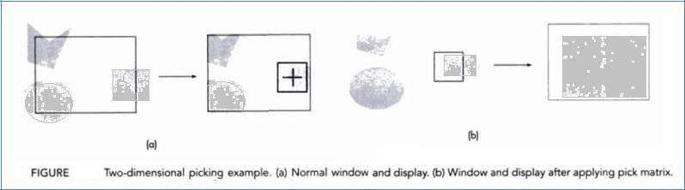
OpenGL allow us to set clipping volume for picking using gluPickMatrix() which is applied before gluOrtho2D.
gluPickMatrix(x,y,w,h,*vp) : creates a projection matrix for picking that restricts drawing to a w x h area and centered at (x,y) in window coordinates within the viewport vp.
(a) There is a normal window and image on the display. We also see the cursor with small box around it indicating the area in which primitive is
rendered.
(b) It shows window and display after the window has been changed by gluPickMatrix.

Slide 44
A SIMPLE CAD PROGRAM
Applications like interactive painting, design of mechanical parts and creatingcharacters for a game are all examples of computer-aided design (CAD). CAD programs allow –
The use of multiple windows and viewports to display a variety of information.
The ability to create, delete and save user-defined objects.
Multiple modes of operations employing menus, keyboard and mouse.
For example, consider the polygon-modeling CAD program which supports following operations:
1. Creation of polygons
2. Deletion of polygons
3. Selection and movement of polygons

Slide 45
BUILDING INTERACTIVE MODELS
Using OpenGL, we can develop a program where we can do insertion,manipulation, deletion etc and we can also build a program which is quite interactive by using the concept of instancing and display lists.
Consider an interior design application which has items likechairs, tables and other house hold items. These items are called the basic building blocks of the application. Each occurrence of these basicitems is referred to as “instance”.
Whenever the instances of building blocks are created by the user usingthe application program, the object (instance) is stored into an arraycalled as “instance table”. We reserve the type 0 to specify that the object no longer exists (i.e., for deletion purpose)
•Now suppose that the user has indicated through a menu that he wishes to eliminate an object and use the mouse to locate the object.
The program can now search the instance table till it finds the object as specified in the bounding box and then set its type to .Hence, next time when the display process goes through theinstance table, the object would not be displayed and thereby it appears that object has been deleted.
• Although the above strategy works fine, a better data structure to implement the instance table is using linked lists instead of arrays.

Slide 46
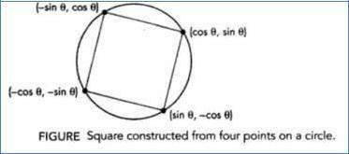
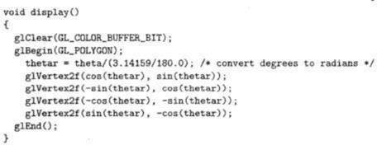
ANIMATING INTERACTIVE PROGRAMS
Using OpenGl, the programmer can design interactive programs.Programs in which objects are not static rather they appear to be movingor changing is considered as “Interactive programs”.
Consider the following diagram
The above square can be displayed as shown below:

Slide 47
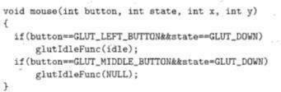
FUNCTIONS TO PERFORM ANIMATION
glutIdleFunc(idle);
glutMouseFunc(mouse);
The above mouse callback function starts the rotation of the image when the left mouse button and when the middle button is pressed it will halt the rotation.
when the above program is executed using single buffering scheme then flickering effect would be noticed on the display. This problem can be overcome using the concept of double buffering

Slide 48
DOUBLE BUFFERING:
Double buffering is a must in such animations where the primitives, attributes and viewing conditions are changing continuously.
Double buffer consists of two buffers: front buffers and back buffers.
Double buffering mode can be initialized:
glutInitDisplayMode(GLUT_RGB | GLUT_DOUBLE);
Further in the display function, we have to include: glutSwapBuffers()to exchange the contents of front and the back buffer.
Using this approach, the problems associated with flicker can be eliminated.

Slide 49
USING TIMER:
To understand the usage of timer, consider cube rotation program and its execution is done by using fast GPU (modern GPUs can render tens of millions of primitives per second) then cube will be rendered thousands of time per second and we will see the blur on the display.
Therefore, GLUT provides the following timer function:
glutTimerFunc(int delay, void(*timer_func (int), int value)
Execution of this function starts timer in the event loop that delays for delay milliseconds. When timer has counted down, timer_func is executed the value parameter allow user to pass variable into the timer call back.

Slide 50
DESIGN OF INTERACTIVE PROGRAMS
The following are the features of most interactive program:
A smooth display, showing neither flicker nor any artifacts of the refresh process.
A variety of interactive devices on the display
A variety of methods for entering and displaying information
An easy to use interface that does not require substantial effort to learn Feedback to the user
Tolerance for user errors
A design that incorporates consideration of both the visual and motor properties of the human

Slide 51
TOOLKITS, WIDGETS AND FRAME BUFFER:
The two examples illustrate the limitations of geometric rendering.
Pop-up menus: When menu callback is invoked, the menu appears over whatever was on the display. After we make our selection, the menu disappears and screen is restored to its previous state.
Rubberbanding: It is a technique used to define the elastic nature of pointing device to draw primitives.

Slide 52
TABLE OF CONTENTS
LOGIC OPERATIONS
XOR AND COLOR
CURSORS AND OVERLAY PLANES

Slide 53
LOGIC OPERATIONS
Two types of functions that define writing modes are:
1. Replacement mode 2. Exclusive OR (XOR)
In case of default mode, consider we start with a color buffer thenhas been cleared to black. Later we draw a blue color rectangle of size 10x10 pixels then 100 blue pixels are copied into the color buffer, replacing100 black pixels. Therefore, this mode is called as “copy or replacement mode”.

Slide 54
Consider the below model, where we are writing single pixel into color buffer.
The pixel that we want to write is called as “source pixel”.
The pixel in the drawing buffer which gets replaced by source pixel is called as “destination pixel”.
In Exclusive-OR or (XOR) mode, corresponding bits in each pixel are combing using XOR logical operation.
•\ If s and d are corresponding bits in the source and destination pixels, we can denote the new destination bit as d‟. d‟ = d ⊕ s
One special property of XOR operation is if we apply it twice, it returns tothe original state, it returns to the original state. So, if we draw some thing in
XOR mode, we can erase it by drawing it again.d = ( d ⊕ s ) ⊕ s
OpenGL supports all 16 logic modes, copy mode (GL_COPY) is the default. To change mode, we must enable logic operation, glEnable(GL_COLOR_LOGIC_OP) and then it can change to XOR mode
glLogicOp(GL_XOR)

Slide 55
XOR AND COLOR
Consider we would like to draw blue color line where 24 bit RGB values(00000000, 00000000, 11111111).
Suppose the screen is clear to write (11111111, 11111111, 11111111)then when we draw blue line using XOR mode, then the resultant linewould appear in yellow color (11111111, 11111111, 00000000) because
XOR operation is applied bit-wise.
This leads to form annoying visual effects.
Therefore, we should use copy mode while drawing final output to get it in required color.

Slide 56
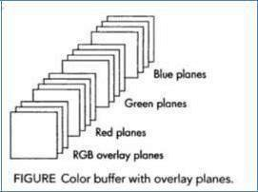
CURSORS AND OVERLAY PLANES
Rubberbanding and cursors can place a significant burden on graphics system as they require the display to be updated constantly.
• Although XOR mode simplifies the process, it requires the system to read present destination pixels before computing new destination pixels
Alternative is to provide hardware support by providing extra bits in the color buffer by adding “overlay planes”.
Therefore, typical color buffer may have 8 bits for each Red, green and blue and one red, one green and one blue overlay plane. i.e., each color will be having its own overlay plane then those values will be updated to color buffer

Slide 57
TABLE OF CONTENTS
Curved surfaces
Quadric surfaces
OpenGL quadric surfaces and cubic surface functions
Bezier spline curves
Bezier surfaces
Opengl curve functions
Corresponding opengl functions

Slide 58
CURVED SURFACES
For the curved objects the equation can be expressed either in parametric form or non parametric form. Curves and surfaces can be described by parameters.
Parametric form:
When the object description is given in terms of its dimensionality parameter, the description is termed as parametric representation.
A curve in the plane has the form C(t) = (x(t), y(t)), and a curve in space has the form C(t) = (x(t), y(t), z(t)).
The functions x(t), y(t) and z(t) are called the coordinates functions.
The image of C(t) is called the trace of C, and C(t) is called a parametrization of C
A parametric curve defined by polynomial coordinate function is called a polynomial curve.
The degree of a polynomial curve is the highest power of the variable occurring in any coordinate function.

Slide 59
Non parametric form:
When the object descriptions are directly in terms of coordinates of reference frame, then the representation is termed as non parametric.
Example: a surface can be described in non parametric form as: f₁(x,y,z)=0 or z=f₂(x,y)
The coordinates (x, y) of points of a no parametric explicit planner curve satisfy y = f(x) or x = g(y).
Such curve have the parametric form C(t) = (t, f(t)) or C(t) = (g(t), t).

Slide 60
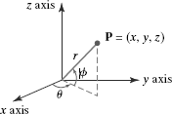

QUADRIC SURFACES
A frequently used class of objects is the quadric surfaces, which are described with second - degree equations (quadratics).
They include spheres, ellipsoids, torus, paraboloids, and hyperboloids.
1. Sphere
A spherical surface with radius r centered on the coordinate origin is defined as the set of points (x, y, z) that satisfy the equation x² + y² + z² = r ²
We can also describe the spherical surface in parametric form, using latitude and
longitude angles as shown in figure

Slide 61
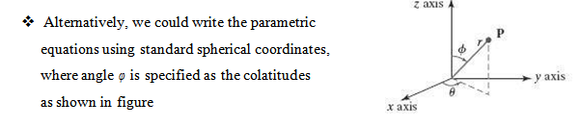

Slide 62
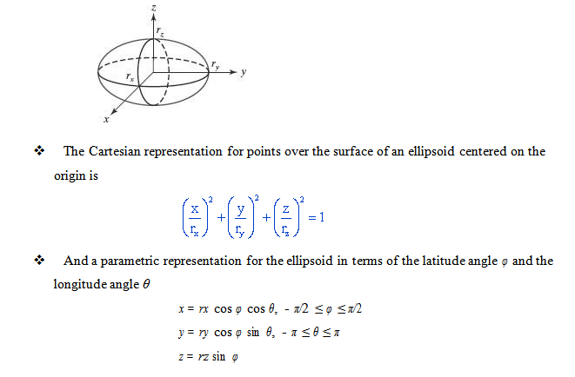
2. Ellipsoid
An ellipsoidal surface can be described as an extension of a spherical surface where the radii in three mutually perpendicular directions can have different values

Slide 63
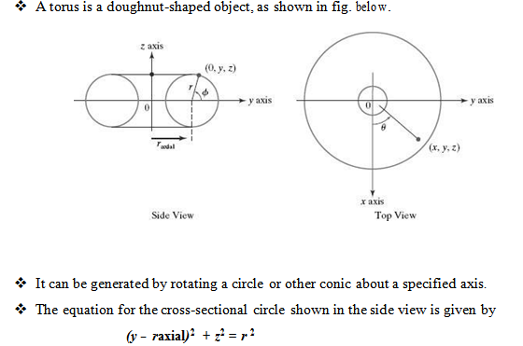
3. TORUS

Slide 64

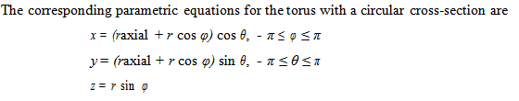
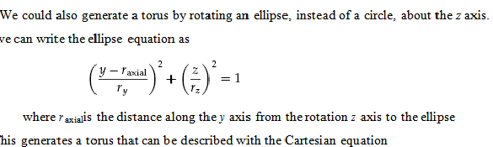

Rotating this circle about the z axis produces the torus whose surface positions are described with the Cartesian equation

Slide 65
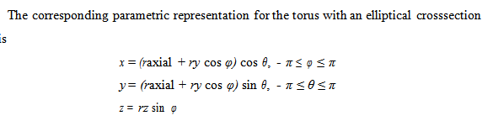

Slide 66
OPENGL QUADRIC-SURFACE AND CUBIC-SURFACE FUNCTIONS
GLUT Quadric-Surface Functions
Sphere Function:
glutWireSphere (r, nLongitudes, nLatitudes); or
glutSolidSphere (r, nLongitudes, nLatitudes);
where,
r is sphere radius which is double precision point.
nLongitudes and nLatitudes is number of longitude and latitude lines used toapproximate the sphere.

Slide 67
Cone Function:
glutWireCone (rBase, height, nLongitudes, nLatitudes); or
glutSolidCone (rBase, height, nLongitudes, nLatitudes);
where,
rBase is the radius of cone base which is double precision point.
height is the height of cone which is double precision point.
nLongitudes and nLatitudes are assigned integer values that specify the number oforthogonal surface lines for the quadrilateral mesh approximation

Slide 68
Torus Function:
glutWireTorus (rCrossSection, rAxial, nConcentrics, nRadialSlices); or
glutSolidTorus (rCrossSection, rAxial, nConcentrics, nRadialSlices);
where, rCrossSection radius about the coplanar z axis
rAxial is the distance of the circle center from the z axis nConcentrics specifies the number of concentric circles (with center on the z axis) to be used on the torus surface,
nRadialSlices specifies the number of radial slices through the torus surface

Slide 69
GLUT Cubic-Surface Teapot Function:
glutWireTeapot (size); or glutSolidTeapot (size);
The teapot surface is generated using OpenGL B´ezier curve functions.
Parameter size sets the double-precision floating-point value for the maximum radius of the teapot bowl.
The teapot is centered on the world-coordinate origin coordinate origin with its verticalaxis along the y axis.

Slide 70
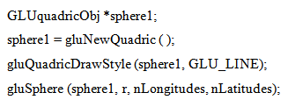

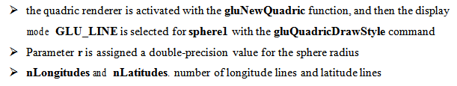
GLU QUADRIC-SURFACE FUNCTIONS
To generate a quadric surface using GLU functions
1. assign a name to the quadric,
2.activate the GLU quadric renderer, and
3.designate values for the surface parameters
The following statements illustrate the basic sequence of calls for displaying a wire- frame sphere centered on the world-coordinate origin:

Slide 71
Three other display modes are available for GLU quadric surfaces
GLU_POINT: quadric surface is displayed as point plot
GLU_SILHOUETTE: quadric surface displayed will not contain shared edges between two coplanar polygon facets
GLU_FILL: quadric surface is displayed as patches of filled area.

Slide 72
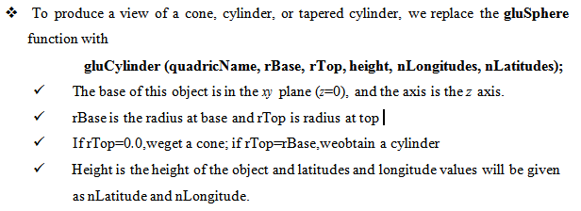
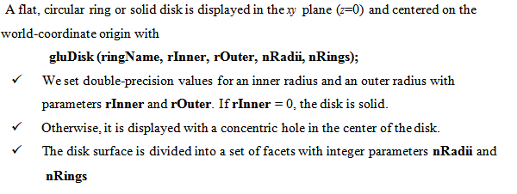

Slide 73
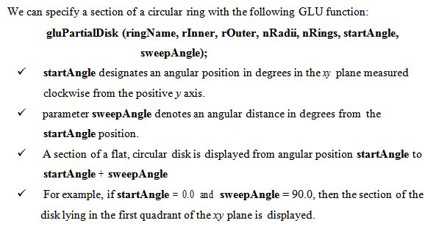
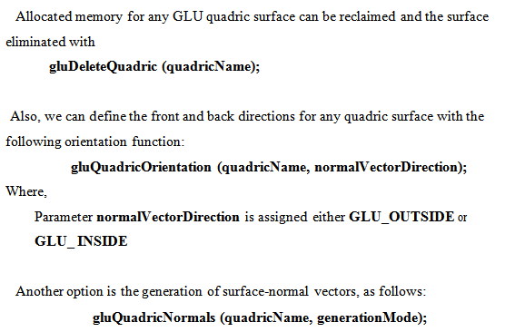

Slide 74
TABLE OF CONTENTS
Bézier Spline Curves
Bézier Curve Equations
Properties of Bézier Curves
Bézier Surfaces
OpenGL Curve Functions

Slide 75
BÉZIER SPLINE CURVES
It was developed by the French engineer Pierre Bézier for use in the design of Renault
automobile bodies.
Bézier splines have a number of properties that make them highly useful and convenient for curve and surface design. They are also easy to implement.
In general, a Bézier curve section can be fitted to any number of control points, although some graphic packages limit the number of control points to four.

Slide 76

BÉZIER CURVE EQUATIONS
We first consider the general case of n + 1 control-point positions, denoted as
p = (x_{k} , y_{k} , z_{k}), with k varying from 0 to n.
These coordinate points are blended to produce the following position vector P(u),which describes the path of an approximating Bézier polynomial function between p and 0

Slide 77

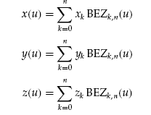
The Bézier blending functions BEZk,n(u) are the Bernstein polynomials
where parameters C(n, k) are the binomial coefficients
A set of three parametric equations for the individual curve coordinates can be
represented as

Slide 78
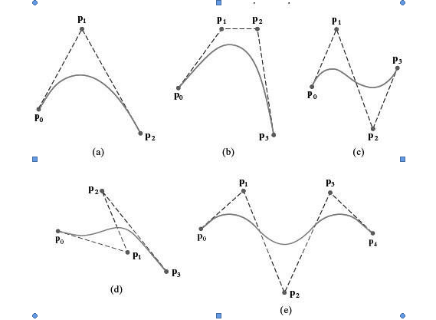

Below Figure demonstrates the appearance of some Bézier curves for various selections of control points in the xy plane (z = 0).
Recursive calculations can be used to obtain successive binomial-coefficient values as
for n ≥ k. Also, the Bézier blending functions satisfy the recursive relationship
BEZ = (1 - u)BEZ + u BEZ ), n > k ≥ 1 (27)
with BEZ = uk and BEZ_{0,} = (1 - u)k .

Slide 79


PROPERTIES OF BÉZIER CURVES
PROPERTY1:
A very useful property of a Bézier curve is that the curve connects the first and last control points.
Thus, a basic characteristic of any Bézier curve is that
P(0) = p0
P(1) = pn
Values for the parametric first derivatives of a Bézier curve at the endpoints can be calculated from control-point coordinates as
The parametric second derivatives of a Bézier curve at the endpoints are calculated as

Slide 80
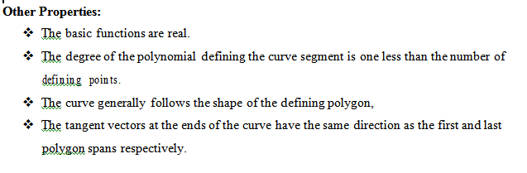

PROPERTY 2:
Another important property of any Bézier curve is that it lies within the convex hull (convex polygon boundary) of the control points.
•This follows from the fact that the Bézier blending functions are all positive and their sum is always 1:

Slide 81

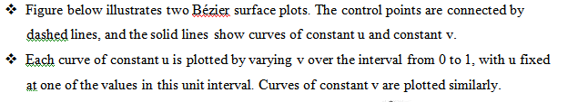
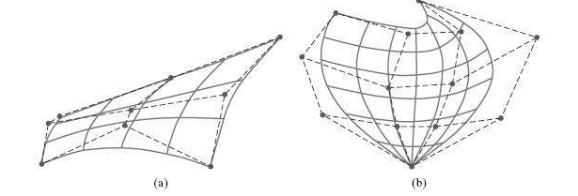
BÉZIER SURFACES
The parametric vector function for the Bézier surface is formed as the tensor product of Bézier blending functions:
with p specifying the location of the (m + 1) by (n + 1) control points

Slide 82
OPENGL CURVE FUNCTIONS
OpenGL Bézier-Spline Curve Functions
We specify parameters and activate the routines for Bézier-curve display with the OpenGL functions
glMap1* (GL_MAP1_VERTEX_3, uMin, uMax, stride, nPts, *ctrlPts);
glEnable (GL_MAP1_VERTEX_3);
We deactivate the routines with
glDisable (GL_MAP1_VERTEX_3);

Slide 83




This Photo by Unknown Author is licensed under CC BY-SA

